Slide 1
Space Invaders
With
Scratch

Slide 2
Setting the stage

Slide 3
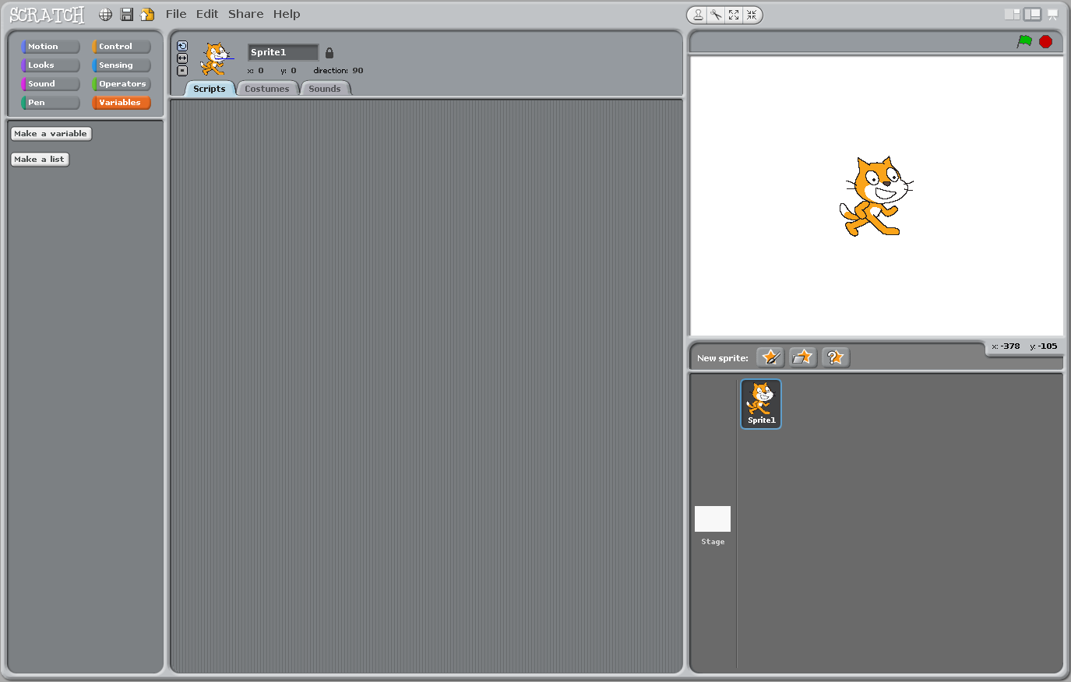
Welcome to Scratch
Tabs
Stage
Sprite
Start/stop
Category
window
Script
window
Sprite
window

Slide 4
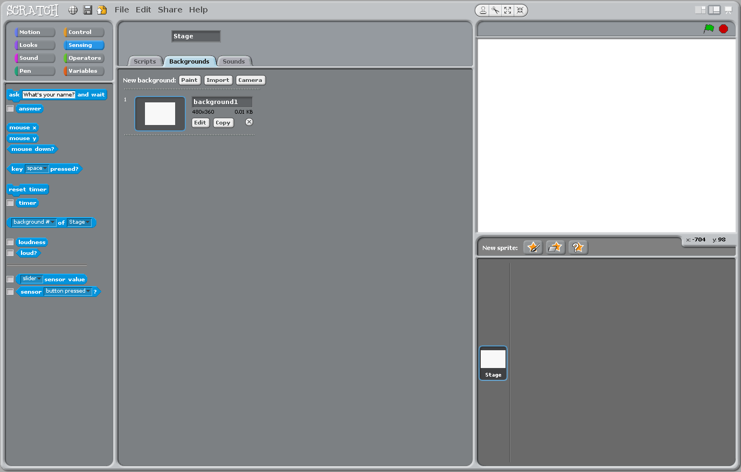
Right-click the cat sprite and delete it

Slide 5
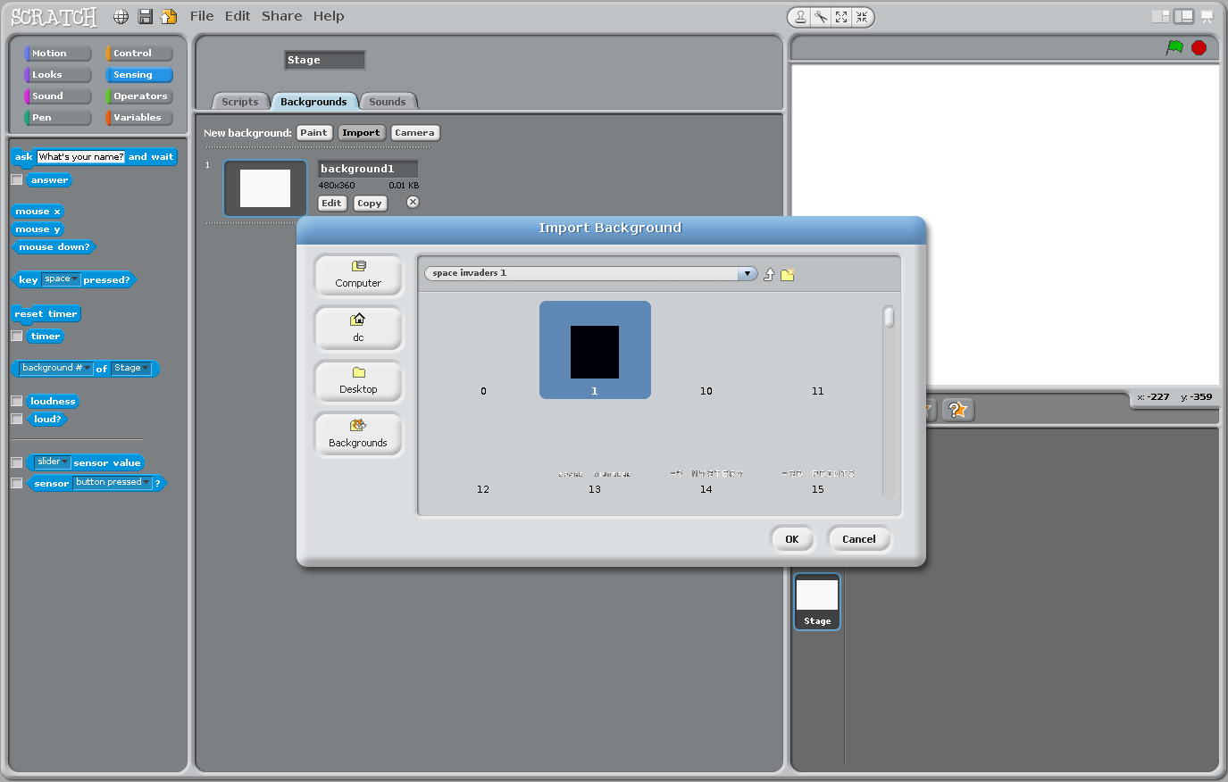
Click on the Backgrounds tab and import a black background

Slide 6
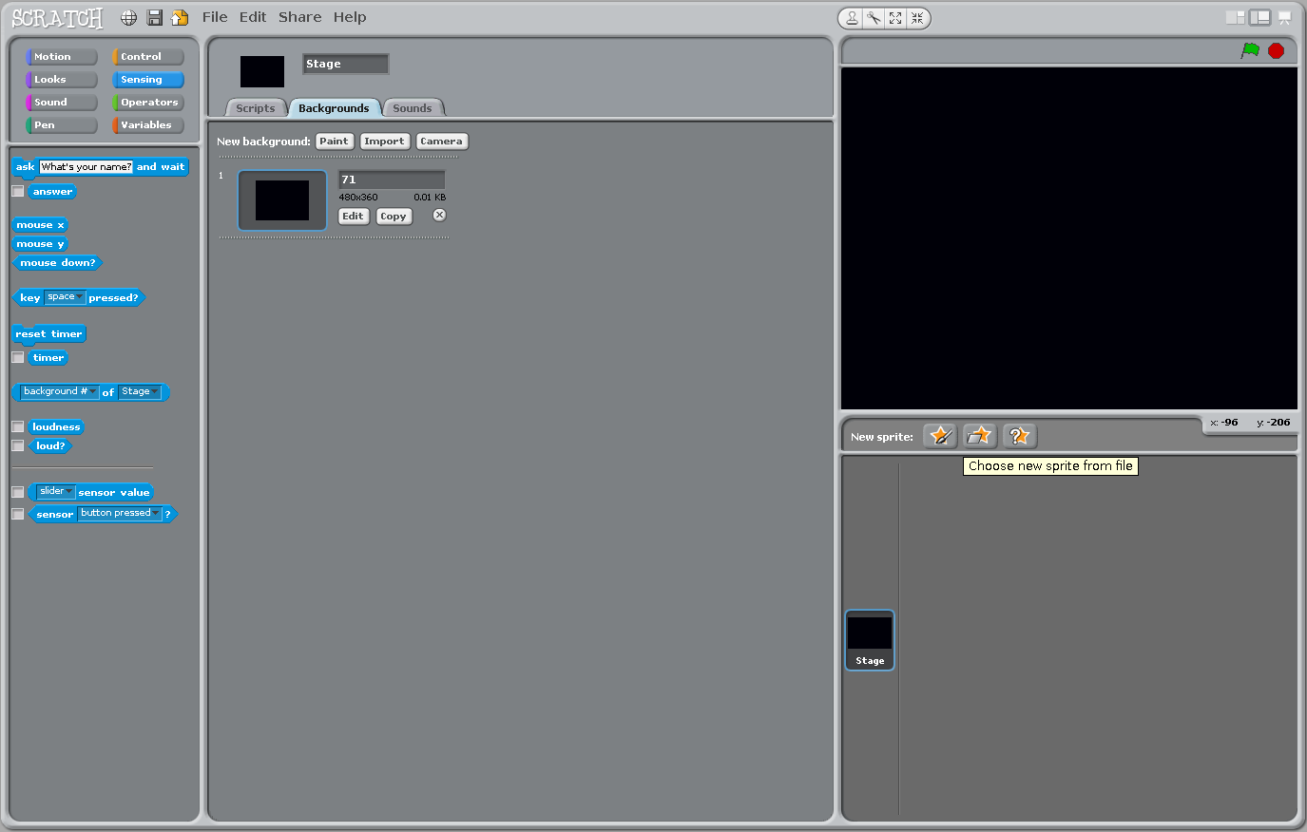
Scratch should now look like this

Slide 7
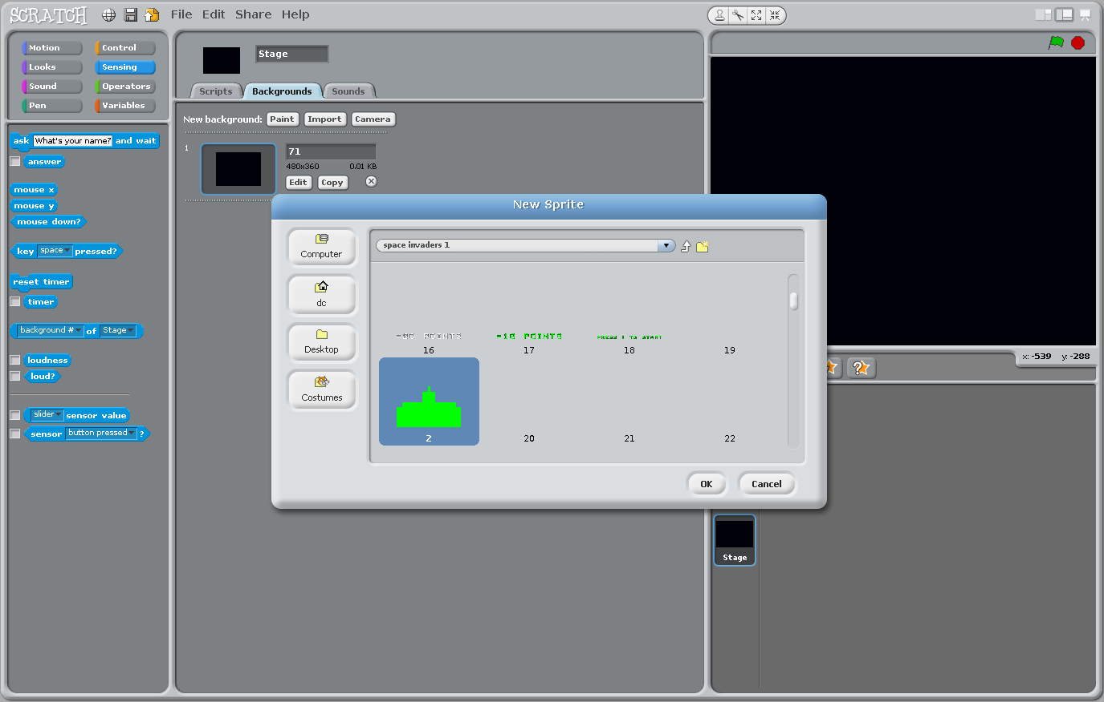
Import the player sprite

Slide 8
Player movement

Slide 9
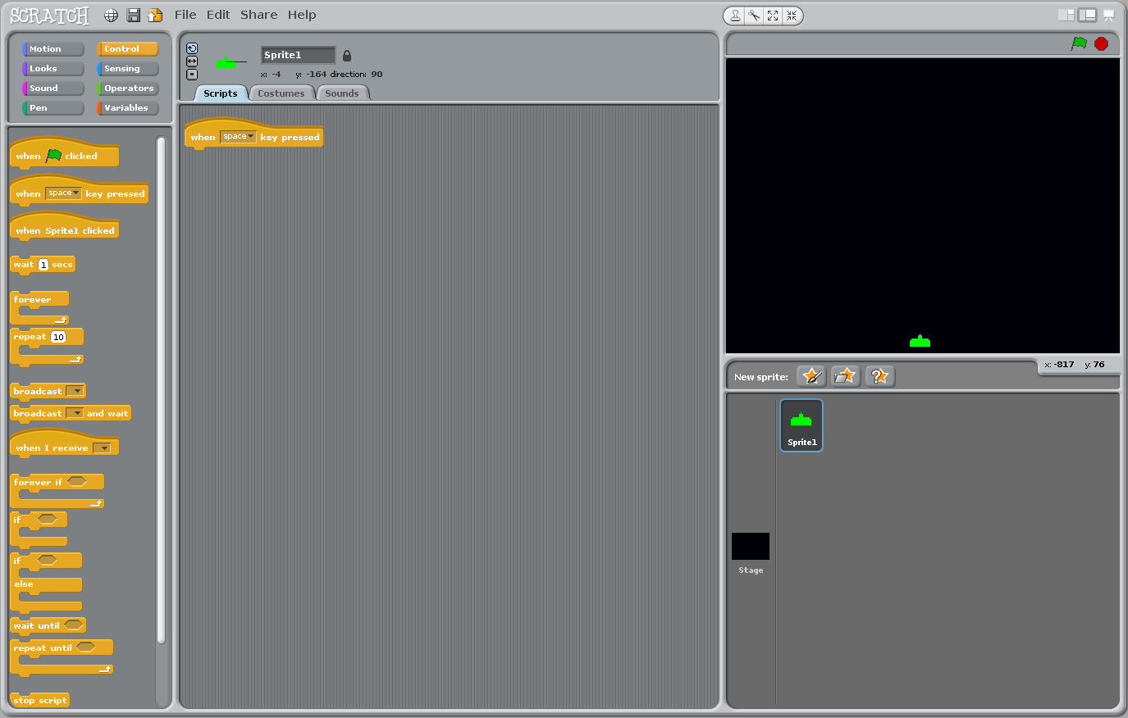
Click the Control category and drag the instruction "when space key pressed" into the scripts window.

Slide 10
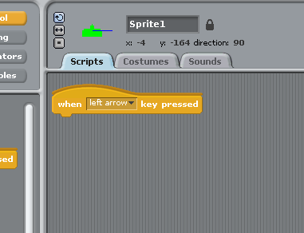
Change the word "space" to "left arrow".

Slide 11
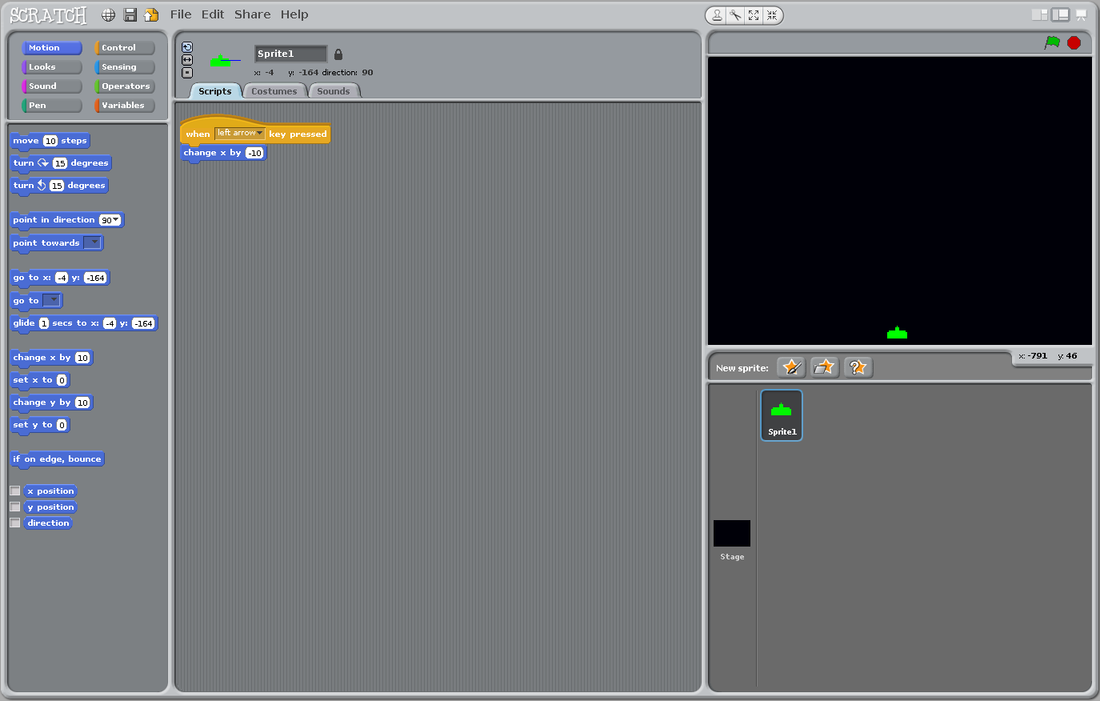
Click the Motion category and drag the "change x by 10" instruction into the scripts window.

Slide 12
Q:
What happens when the left arrow key is pressed?
Why?

Slide 13
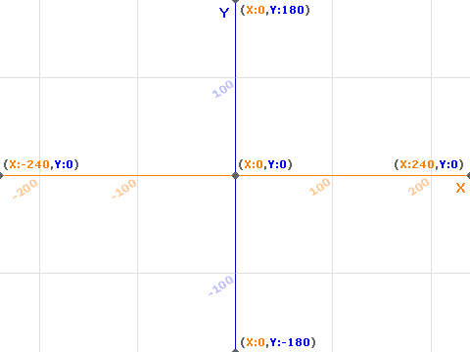
The centre of the stage is actually 0, 0. So, to move left, we need to use minus 10 not plus 10.

Slide 14
Change 10 to -10 in the "change x by" instruction.

Slide 15
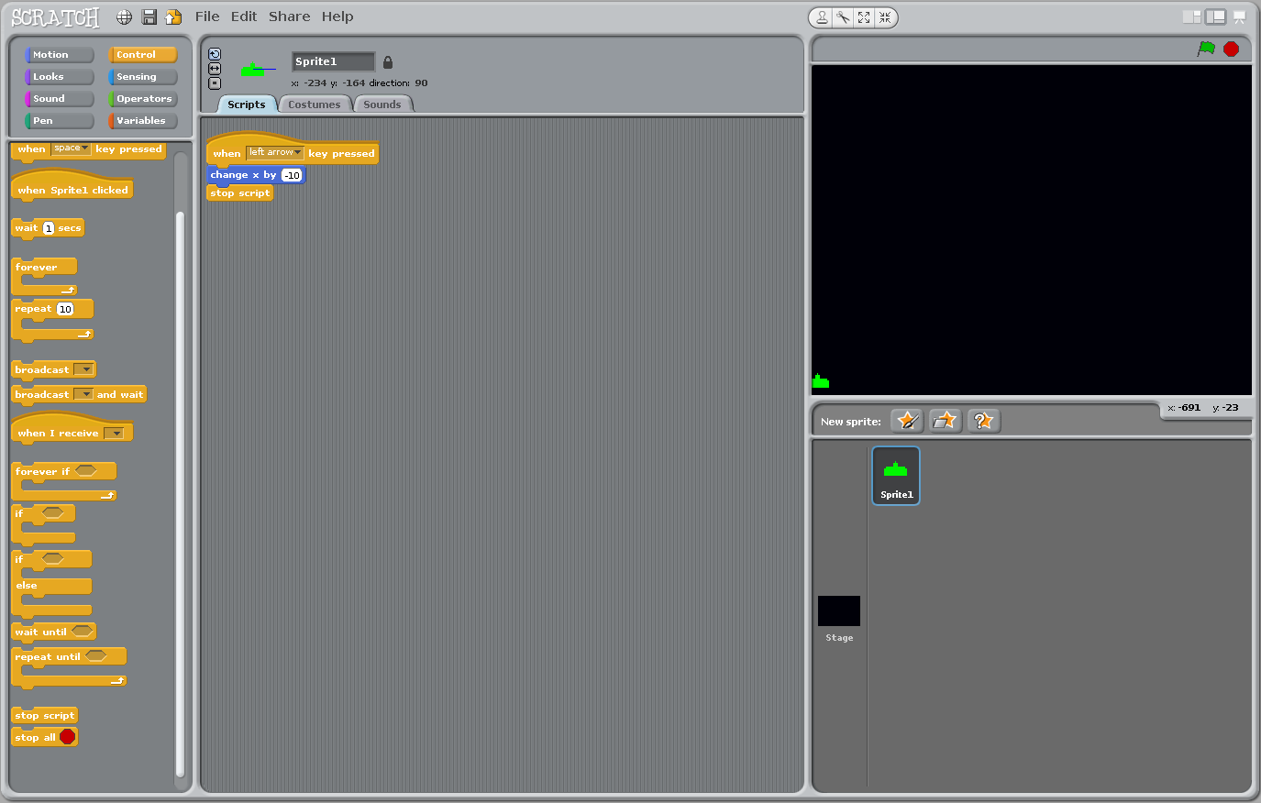
Add a "stop script" instruction. Not strictly necessary but good practice.
Does the player sprite move left now?

Slide 16
Q:
Does this look familiar?

Slide 17


This is the Scratch version of a flowchart.
Start
Process
Stop

Slide 18
Activity (5 minutes):
Can you create a script to move the player right as well as left?

Slide 19
Alien movement

Slide 20
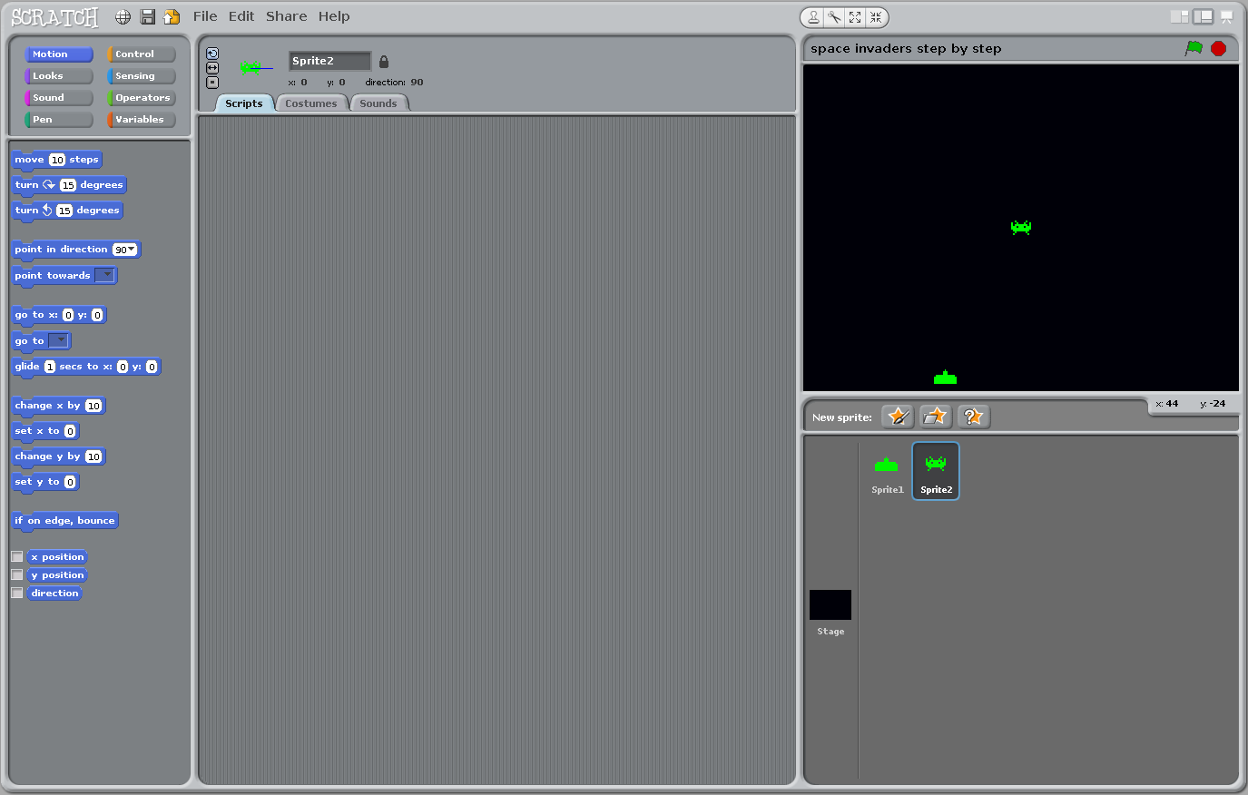
Find and import an alien sprite.

Slide 21
IMPORTANT!!!
Notice that the script window changes for each sprite you click.
Each sprite can have its own scripts.

Slide 22
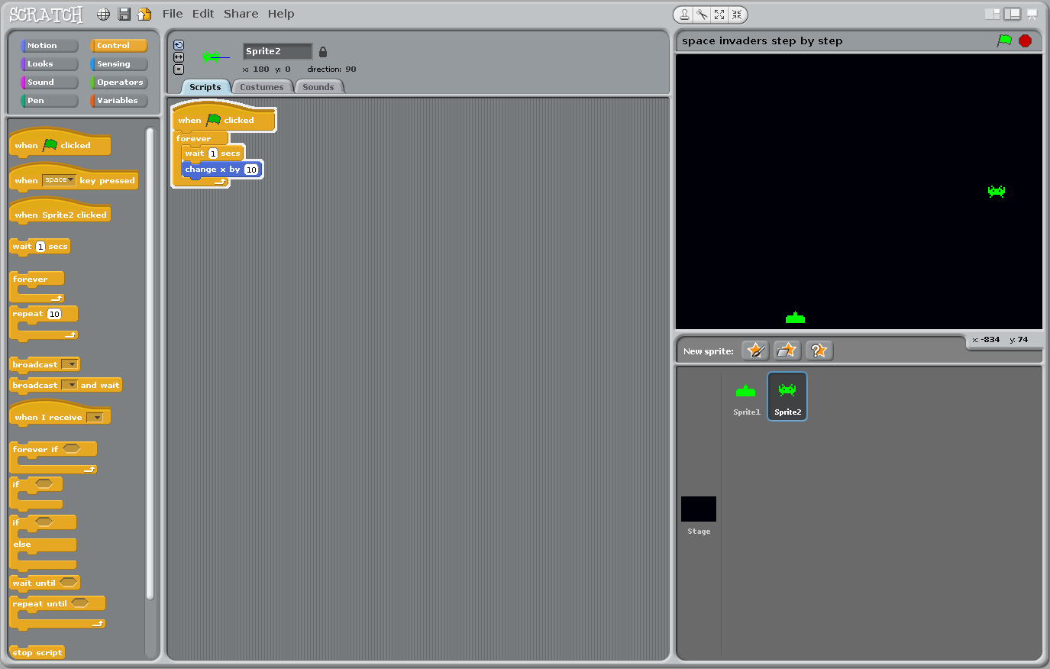
Activity (10 minutes):
Can you make the alien move to the right 10 pixels every second?
Start with this:

Slide 23
Another clue:

Slide 24
Did you get something like this?

Slide 25
Direction change

Slide 26
Q:
In the Space Invaders game we played, the aliens changed direction when they reached the end of the stage.
How can we do this?

Slide 27
We need two things:
1. A way of telling the alien sprite to change its X direction.
2. A way of sensing if the alien sprite has reached the edge of the stage.

Slide 28
Remember the stage coordinates?
To change direction, we can use a variable that can be either positive to move right or negative to move left.
Click the Variables
category
Click Make a variable

Slide 29
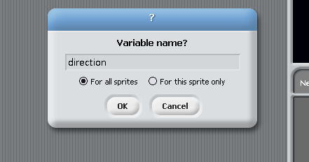
Create a variable called "direction".

Slide 30
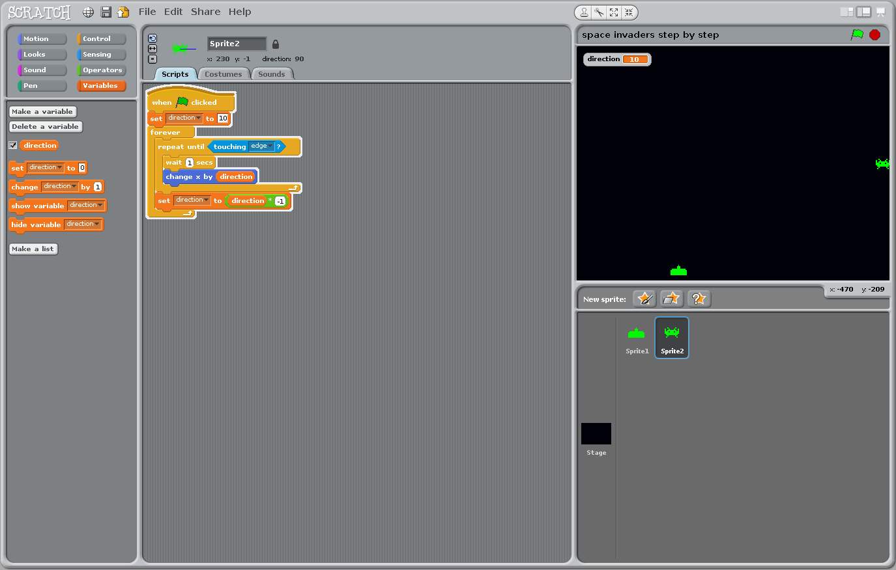
We can replace the value 10 in the "change x by" instruction with our new direction variable by dragging and dropping.

Slide 31
To check if the alien has reached the edge of the stage, we can use a sense instruction:

Slide 32
Now, we can put these two things into our alien sprite script:
Initial direction
The sense
instruction
The "direction"
variable

Slide 33
One final thing for our alien sprite:
To make "direction" flip between positive and negative, we can multiply by minus 1.

Slide 34
Q:
Where is the best place to insert this instruction?

Slide 35
Here's the movement code for the alien sprite.
Try it and see if it works.
The alien sprite should move in the opposite direction when it touches the edge of the stage.

Slide 36
Q:
What happened?
Why?

Slide 37
The sprite got stuck on the edge because once it is touching the edge, it will keep exiting out of the loop and never move.

Slide 38

We need to add another "change x by" instruction to nudge it away from the edge of the stage.
Add this to yours and try it out.

Slide 39
Costumes

Slide 40
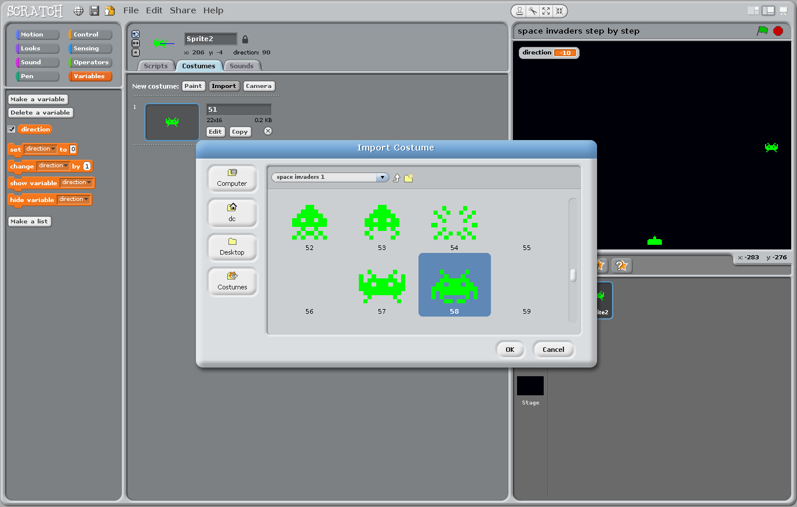
When we played the Space Invaders game, did you notice that the aliens changed appearance with each step?
This gave the appearance that the sprite was walking.

Slide 41
We can do this with a "costume change."

Slide 42
Click the "Costumes" tab and import the sprite for the costume change.

Slide 43
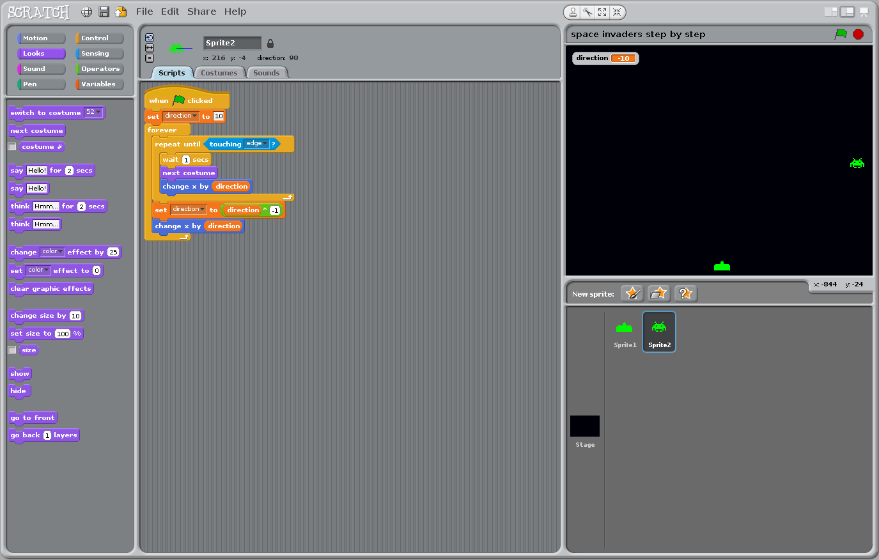
To use the new costume, simply click on the "Looks" category and drag the "next costume" instruction into your script.

Slide 44
Q:
Where is the best place to put "next costume" if we want to swap between each costume with each step?

Slide 45
If we put the "next costume" instruction here, the sprite should change appearance each time it moves. Try it now.

Slide 46
Moving downwards

Slide 47
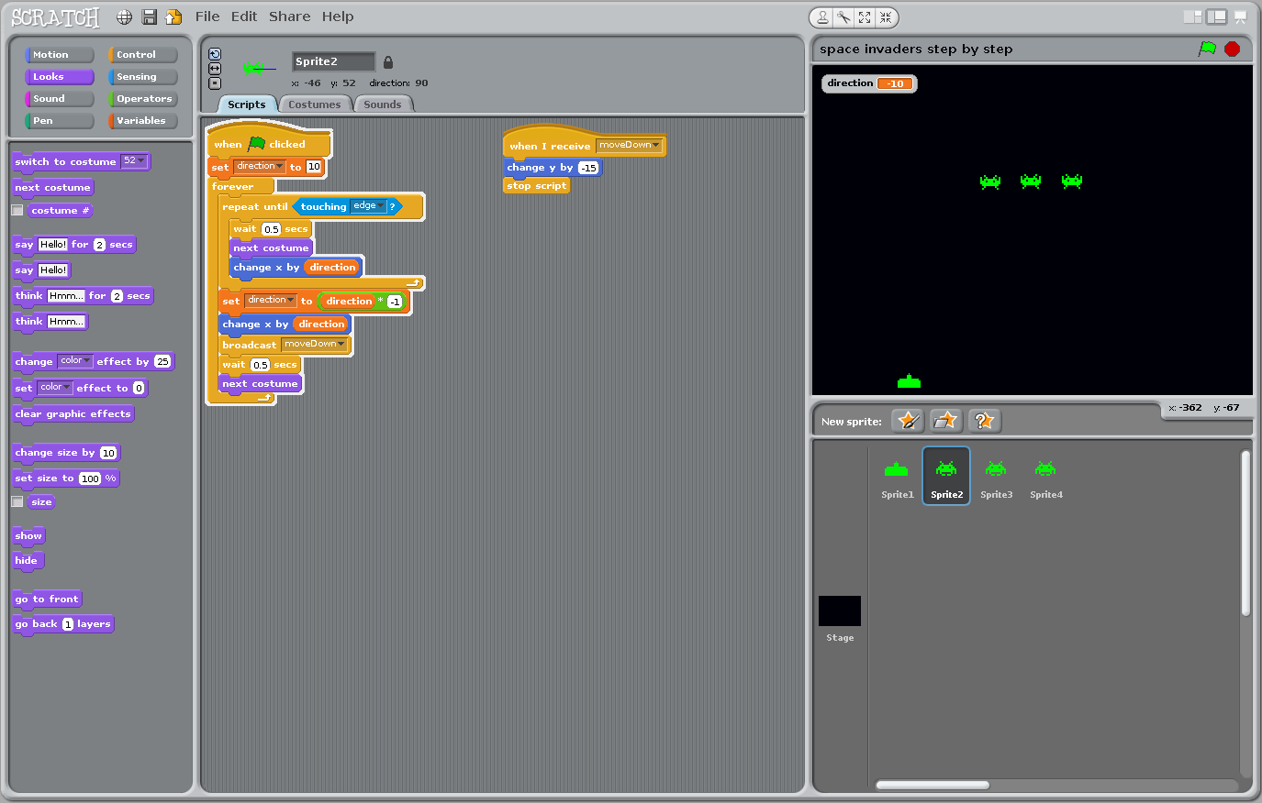
In the Space Invaders game we played, the alien sprites moved down when one of them touched the edge of the stage.

Slide 48
Q:
Which axis corresponds to up and down? X or Y?

Slide 49
Activity (10 minutes):
Add some code to make the alien sprite move down 10 pixels when it reaches the edge of the stage.

Slide 50
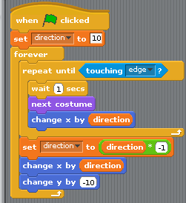
How you could have done it:

Slide 51
Duplicate your alien sprite four or five times. Line the aliens up and run your code.
To duplicate your alien sprite, right click on it and choose "Duplicate."
When you duplicate like this, all of the sprite's scripts and costumes are copied with it.

Slide 52
Q:
What happened to your aliens?
How could this be improved?

